Slide 1


Slide 2



Let's check your understanding

Slide 3


Slide 4


Slide 5
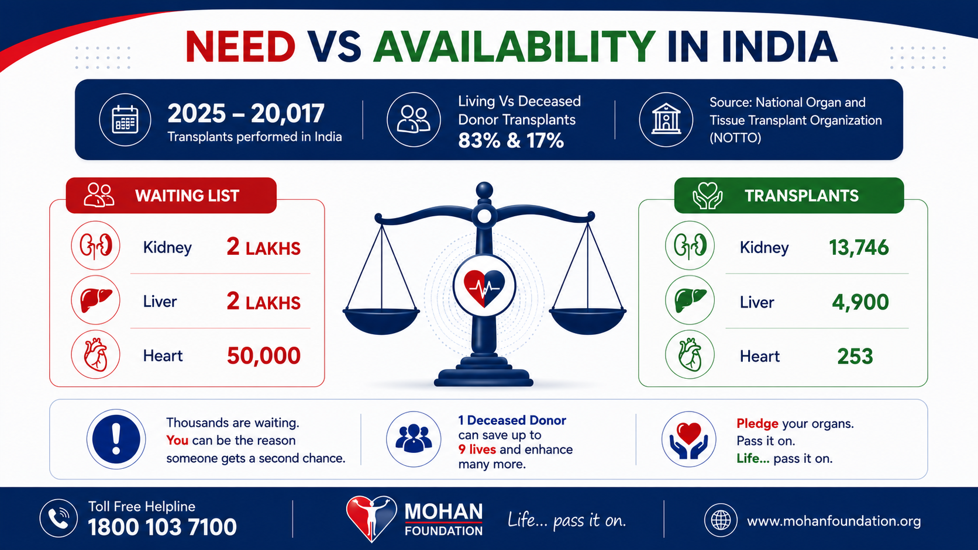

Slide 6


Slide 7
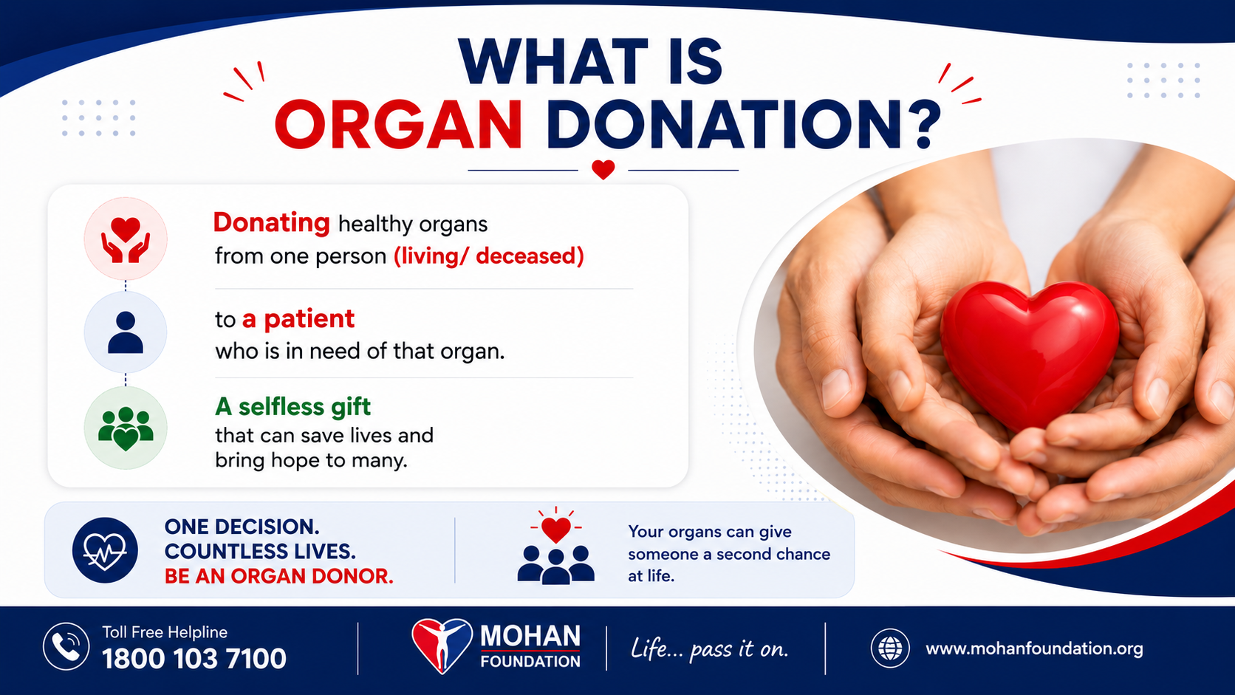

Slide 8
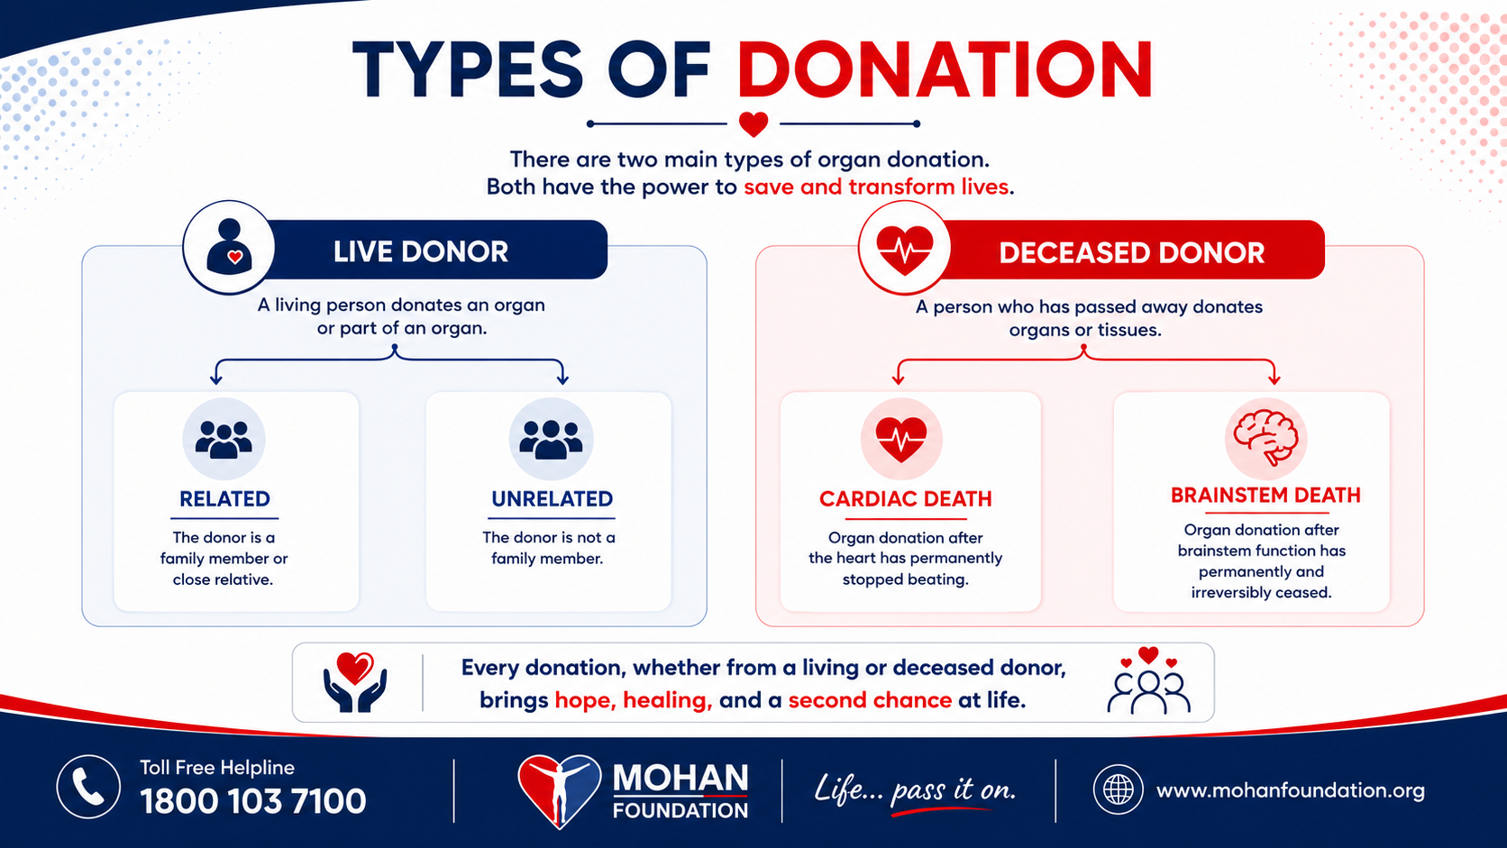

Slide 9
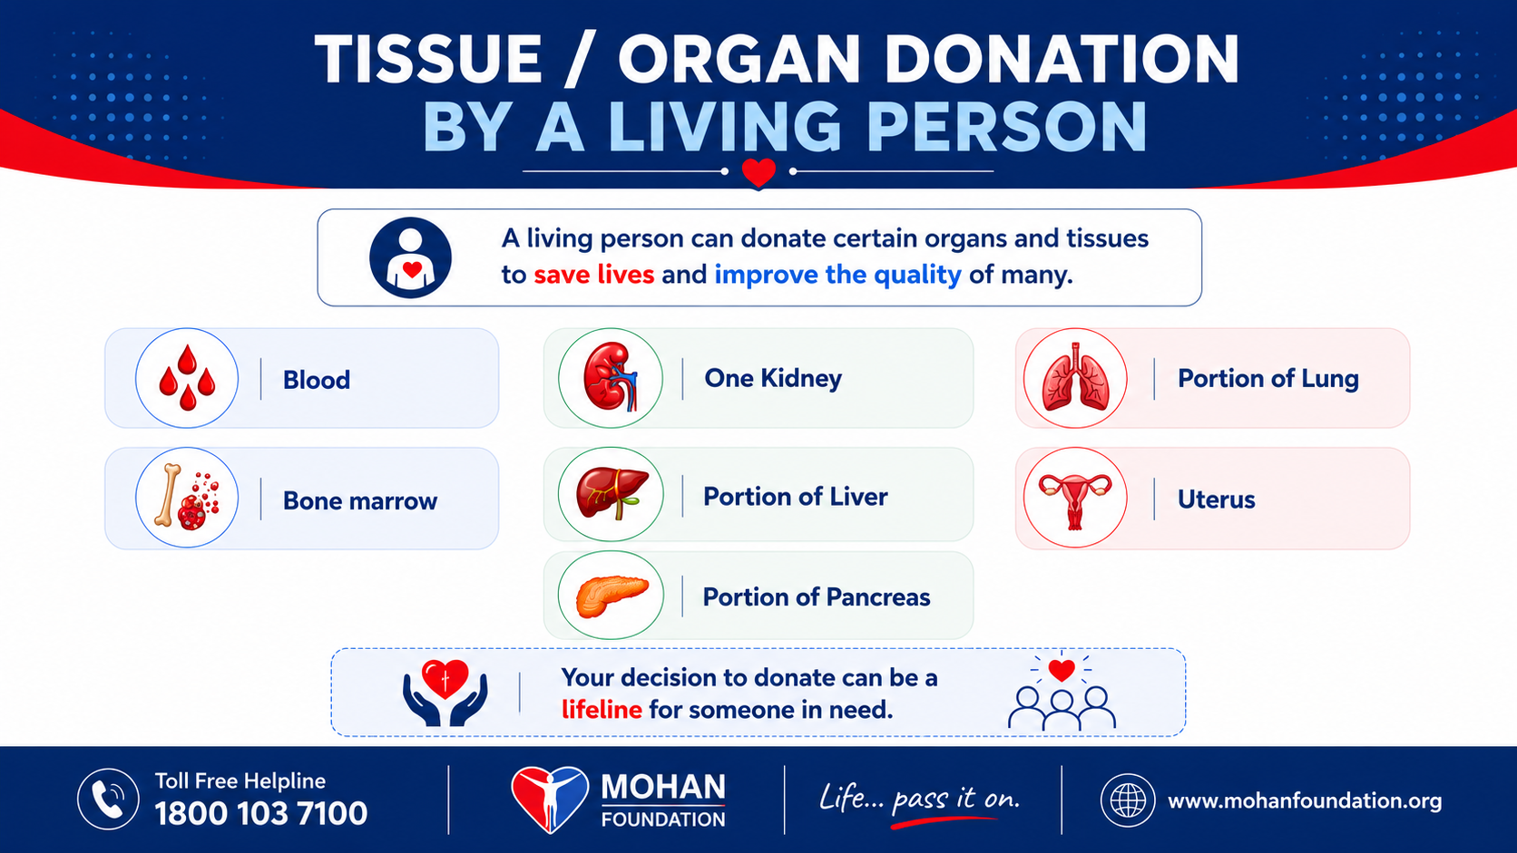

Slide 10
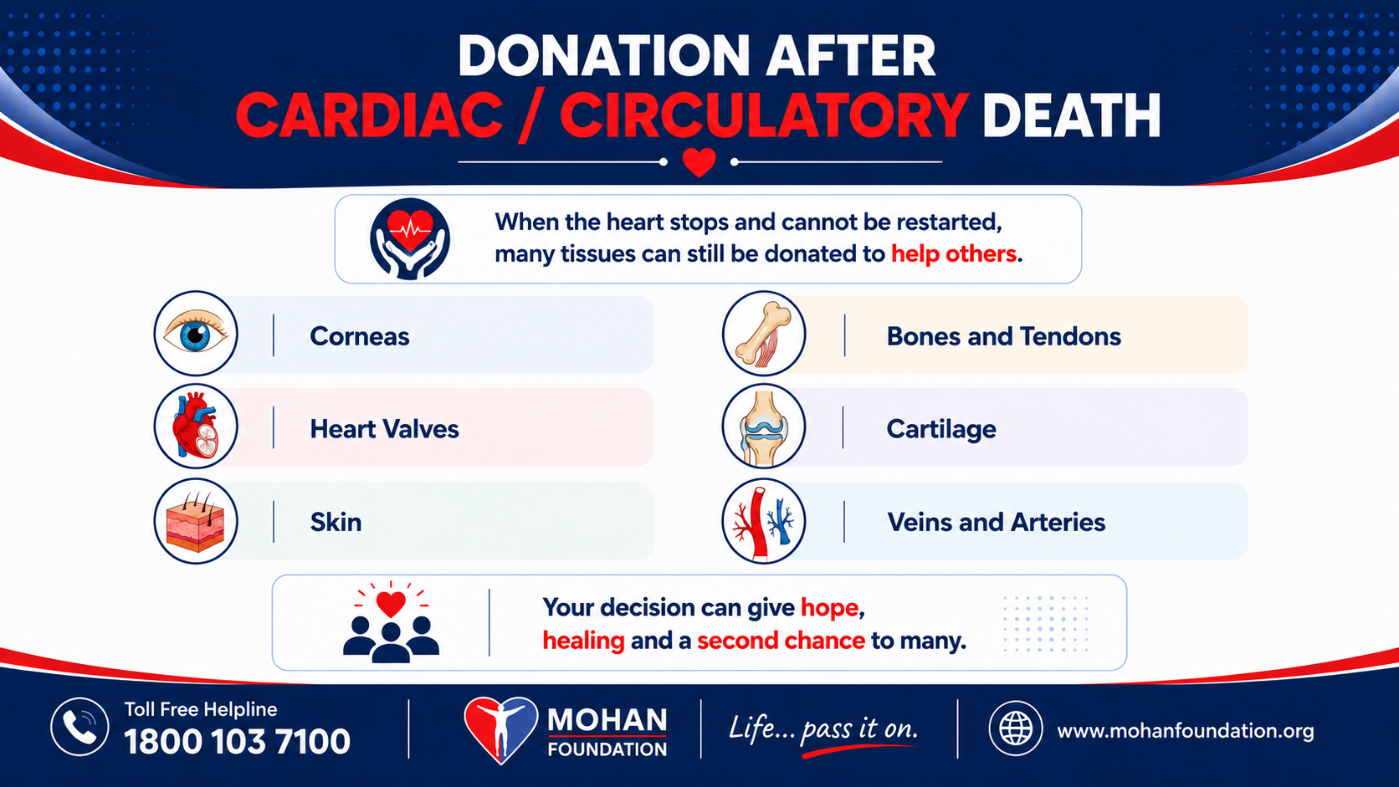

Slide 11
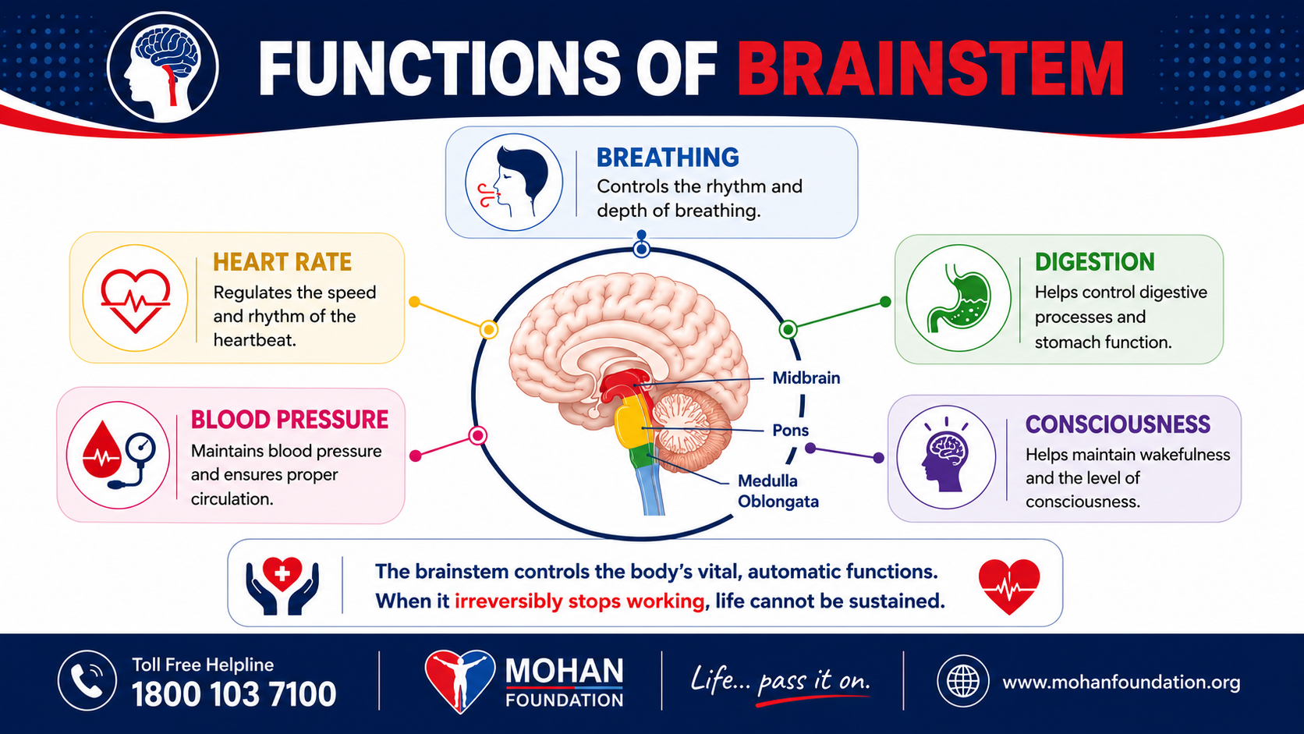

Slide 12
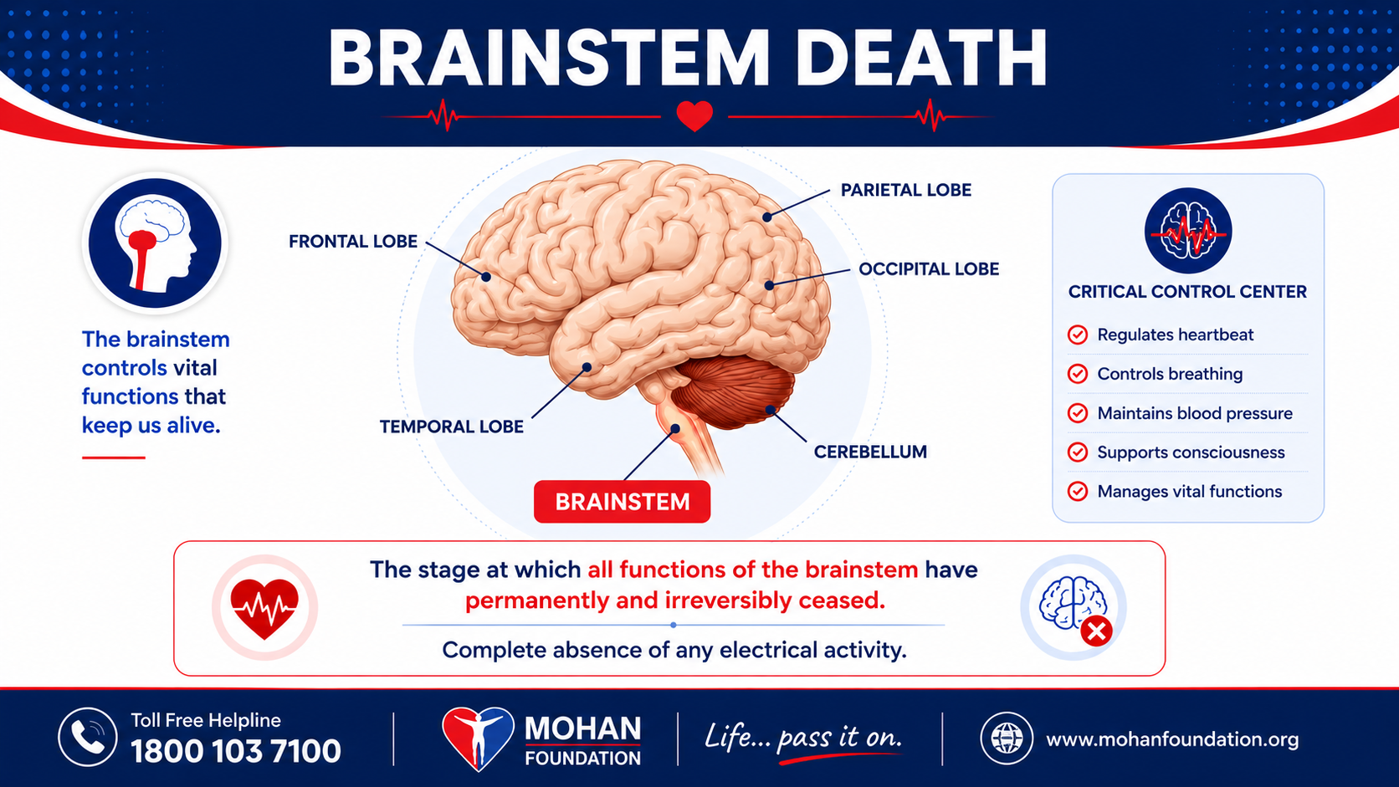



Slide 13
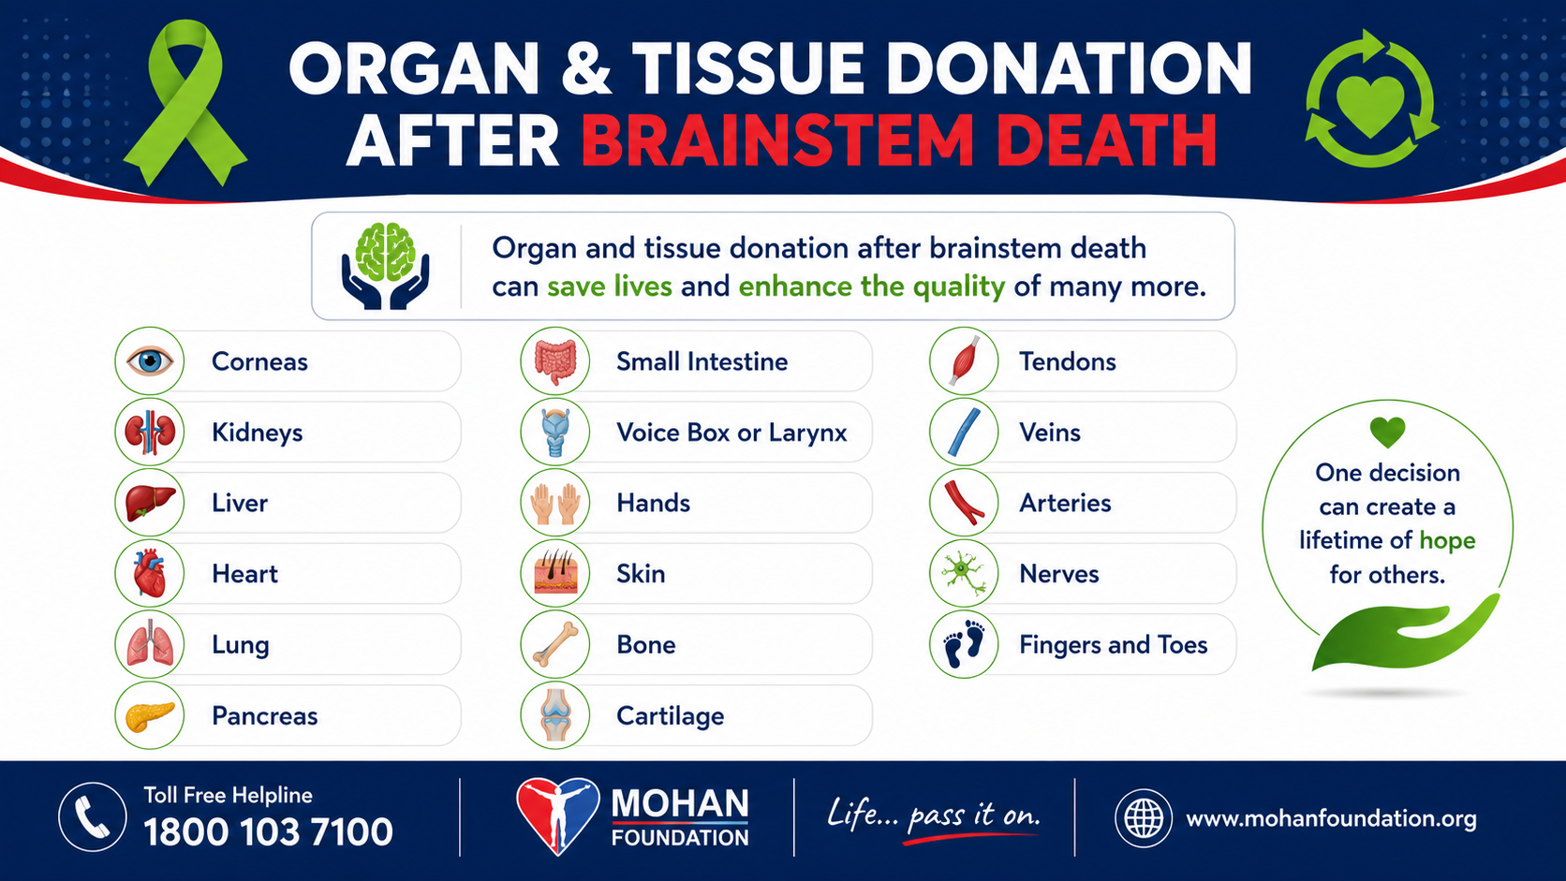

Slide 14

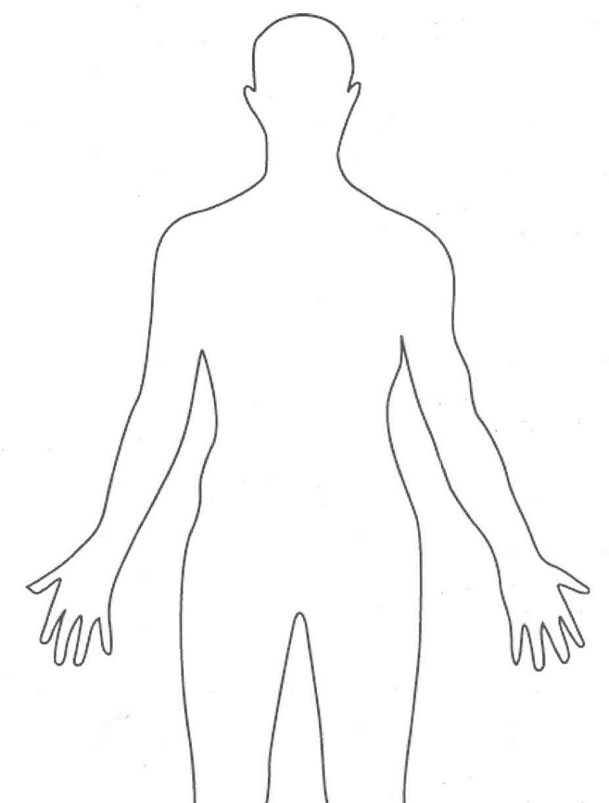

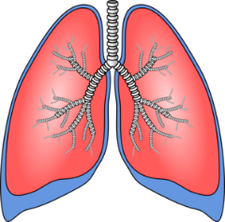

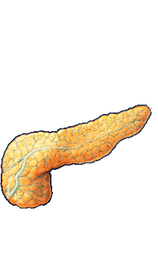
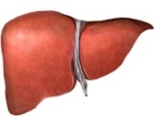
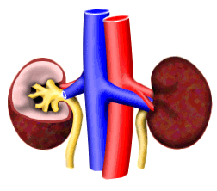
Tissues & Organs ….. Storage Limits
Race Against Time
Eye (2) – 6 hours
Lung (2) – 6 hours
Heart (1) – 6 hours
Liver (1) – 12 hours
Pancreas (1) – 24 hours
Kidney (2) – 48 hours
Organ retrieval Transplant
DONOR
RECIPIENT

Slide 15



Slide 16
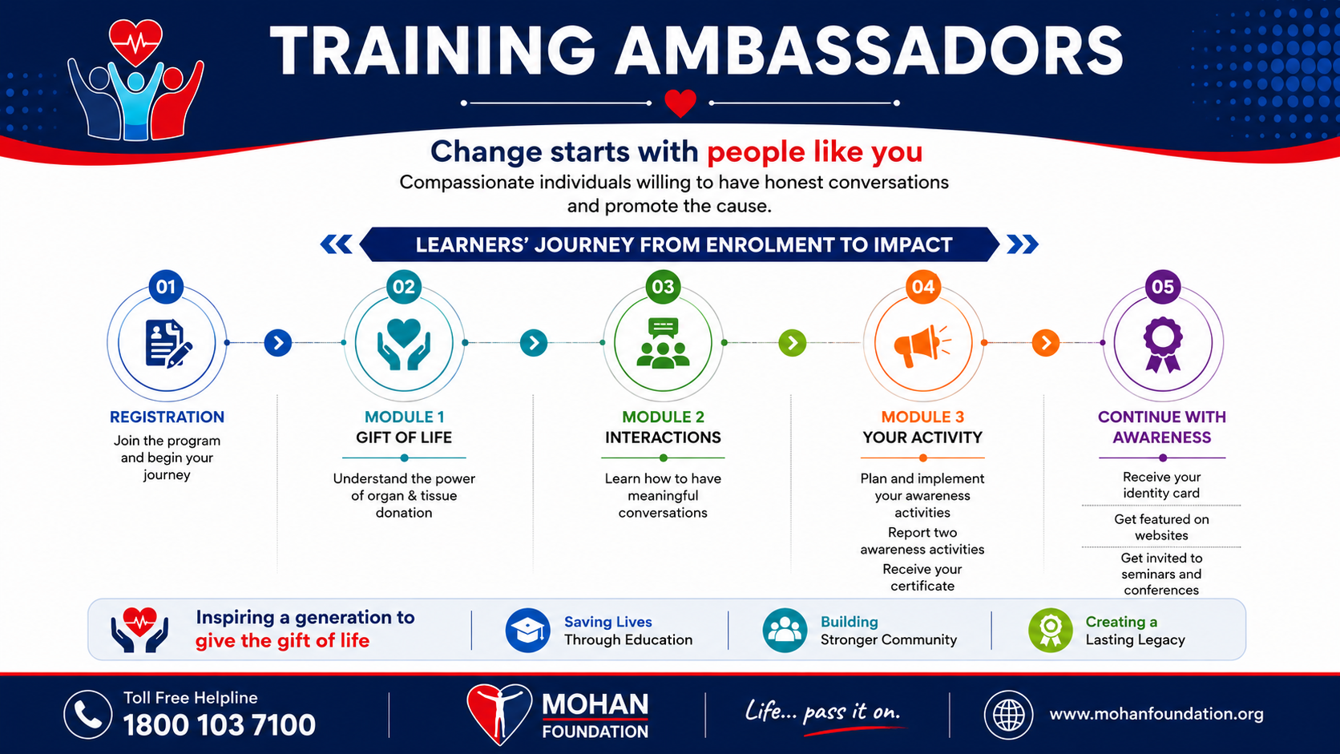

Slide 17

MODULE 3 - ENCOURAGING INITIATIVES, ASSISTANCE & MENTORING
Verifying Presentation content, Providing collaterals, Clearing doubts, Mentoring
Ongoing support and assistance during the Activity
Activity reports & photographs
Awarding Certificates

Slide 18
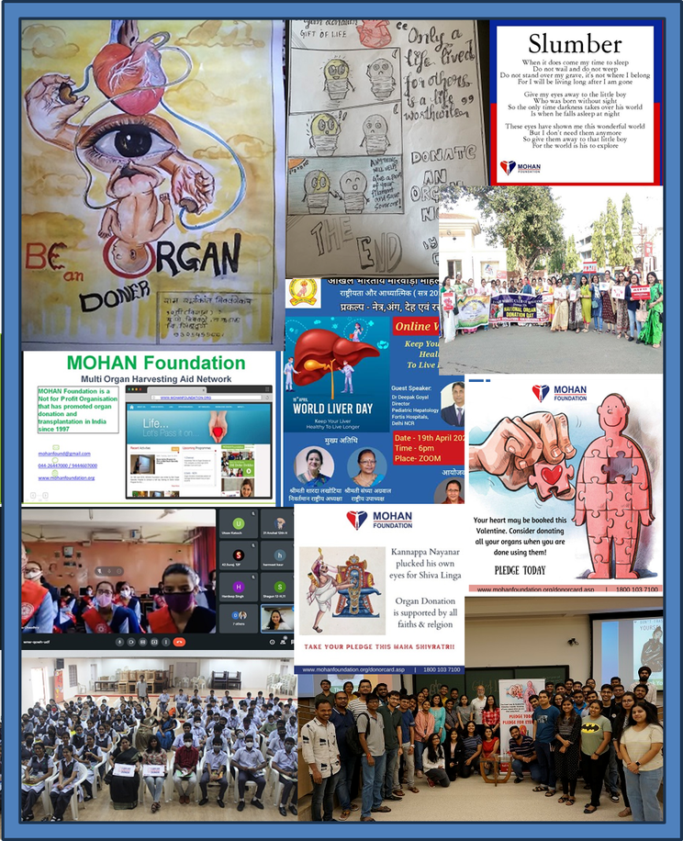
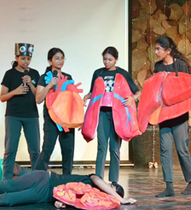
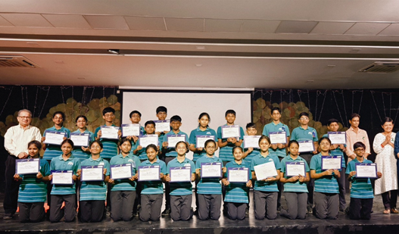
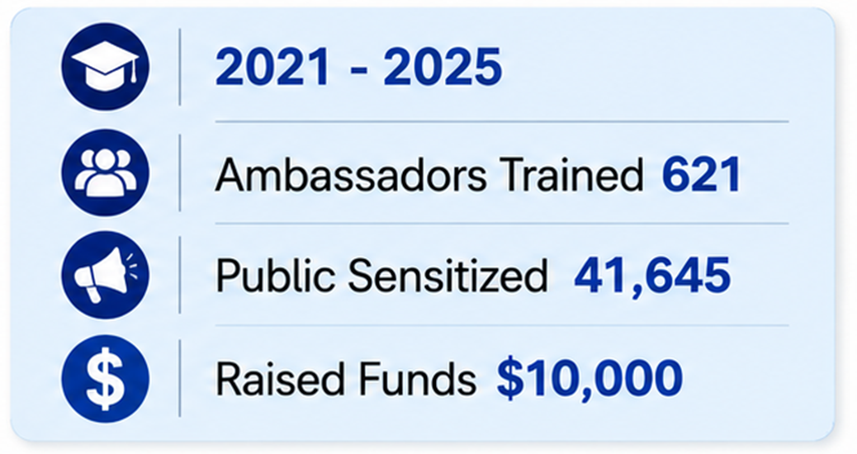
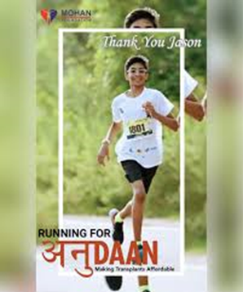
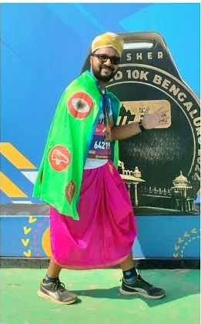
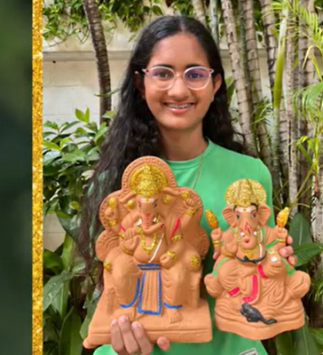
Jason Joshua Moses
Grade 11
Vedanta Delhi Half Marathon (VDHM)
Raised ₹2.7 lakh
Anant Acharya
Bengaluru Tata Marathon Majja Run
Influencing more than 6000 people
Krisha Toshniwal Grade 11
Eco friendly Ganesha
Donated sale proceeds to Anudaan

Slide 19
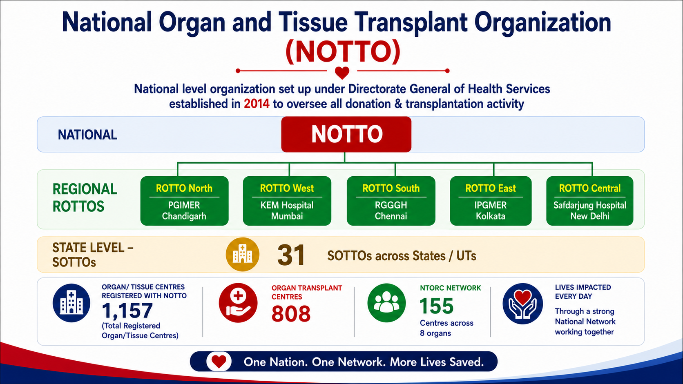

Slide 20
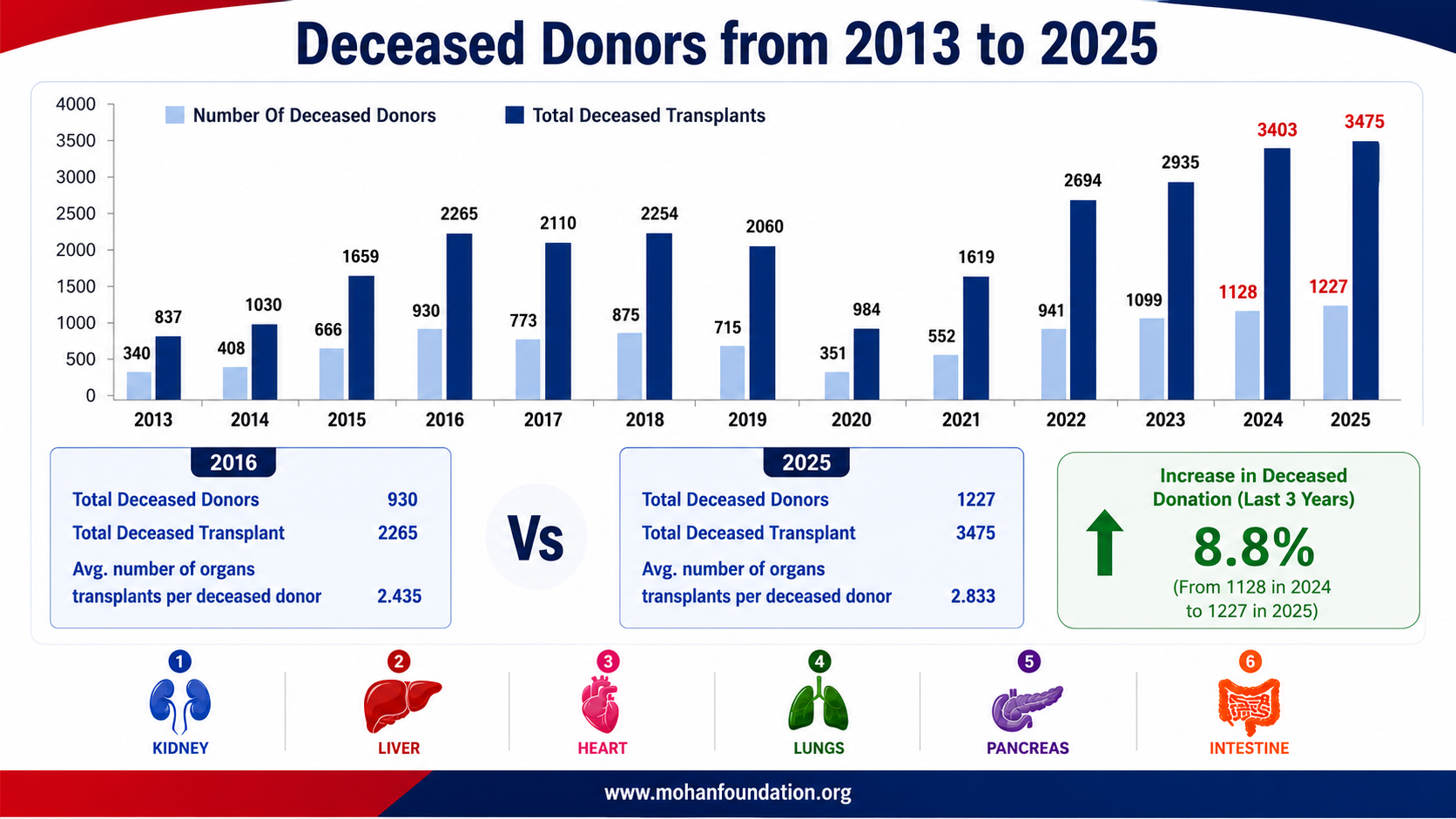
Deceased donation rate 0.9pmp
Source: NOTTO

Slide 21
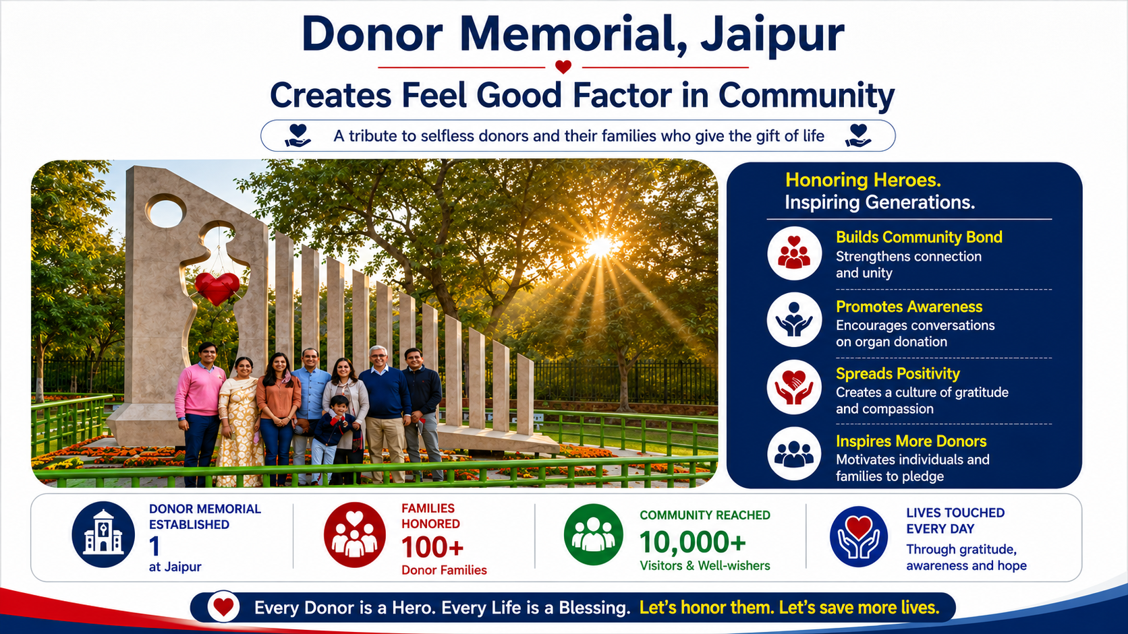

Slide 22
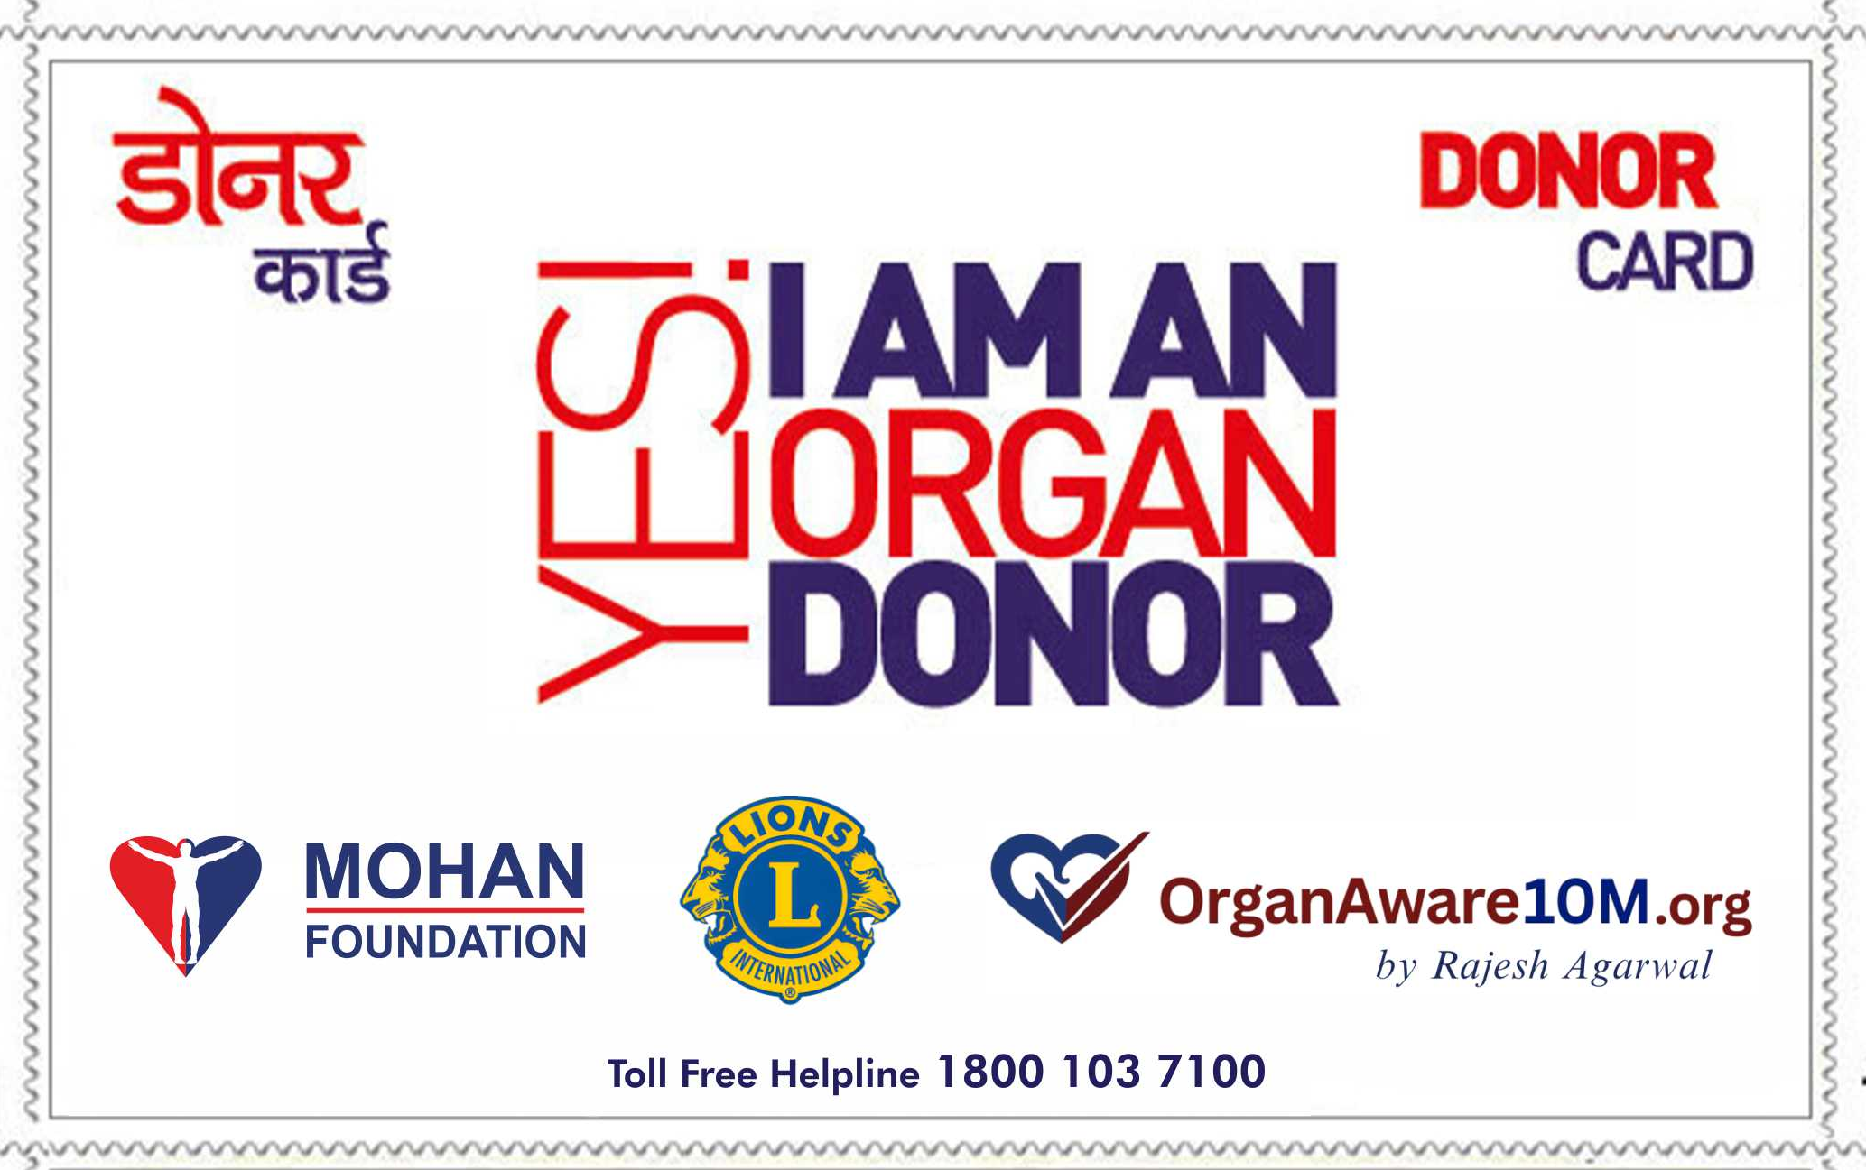
Say "Yes" to organ donation
Scan for your donor card

